Slide 1
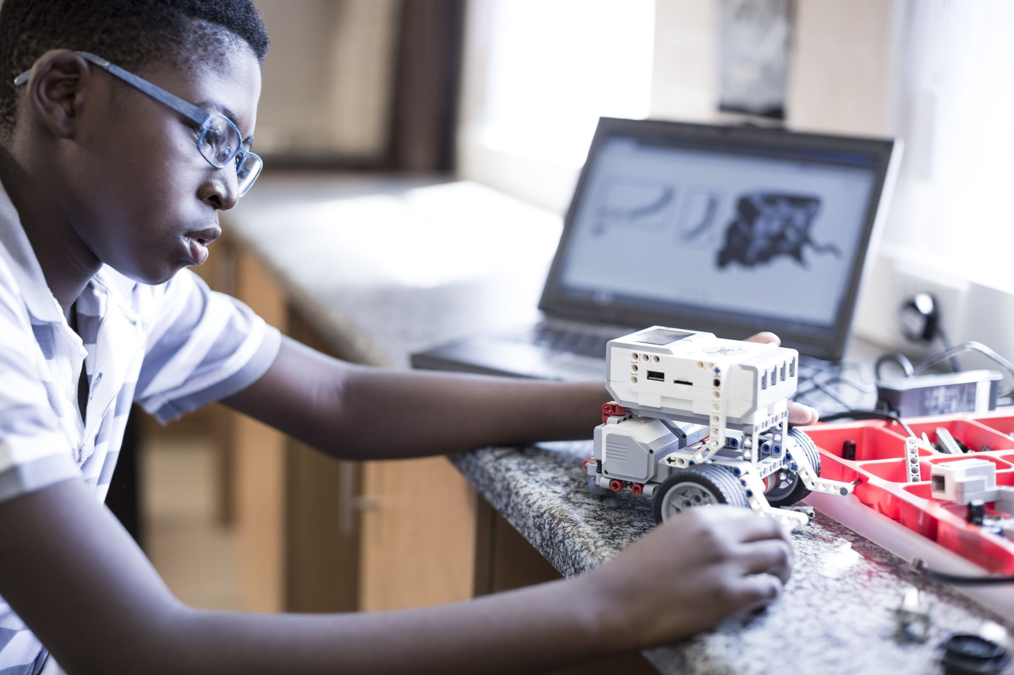
INTRODUCTION
Name: Njuguna Jackson Maganga
son to: Kiemo Kennedy Njuguna
Njuguna Beatrice Mkawughanga

Slide 2

Background:
Born and raised in Kangari Town, Muranga County
Fascinated by technology from a young age
Tinkering with gadgets and exploring basic computer programs

Slide 3

Family Background
Supportive family environment
Encouraged to explore my interests
Importance of hard work and dedication instilled from a young age

Slide 4


Education
Strong foundation at Njiiri High School
Fostered problem-solving skills, critical thinking, and a love for learning
DeKUT: A catalyst for growth
BBIT program equipped me with a comprehensive understanding of IT

Slide 5


Programming Expertise
Proficiency in programming languages like Java, R, and Python
Ability to translate ideas into functional code

Slide 6

Beyond Programming
Database management skills
Understanding of network design and administration
Problem-solving skills
Data Analysis
People skills

Slide 7



HOBBIES
Reading books
Movies
Playing Soccer
Outdoor activities
Sleeping

Slide 8


Experience
Internship at Nyeri Referral Hospital as an IT Administration Intern
Applied theoretical knowledge to real-world situations
Honed adaptability and problem-solving skills

Slide 9

Reflections and Future Goals
Commitment to continuous learning
Importance of perseverance and overcoming challenges

Slide 10


Thank You DeKUT. God Bless you all.

Slide 11


